Slide 1
From Chaos To Clarity:
Enabling Data teams with observability
Jacqueline Lee
jbilston@yelp.com

Slide 2

Talk Resources
Some images in this slide deck are generated with AI. These images are not official Yelp-generated images

Slide 3
Who is using my data?

Slide 4
Backbone Code
session_summary
sessions
Notes:
Here’s the thing though… neither of these tables are real, they never existed at Yelp, and this migration never actually happened. They are a simplification of years of migrations, incidents and interacting with internal customers so we can talk about what matters ad we don’t get bogged down in details.
It also lets me share specific table details and code with you, which is important… because I’ll want your input on this migration. I want to know what decisions you’d make at various points in the story.

Slide 5


session_summary
sessions
Notes:
But what if we take too long checking everything? Well… then we lose momentum.
Stakeholders get tired. We get tired. And suddenly… we’re maintaining two tables forever.
Ask me how I know.

Slide 6

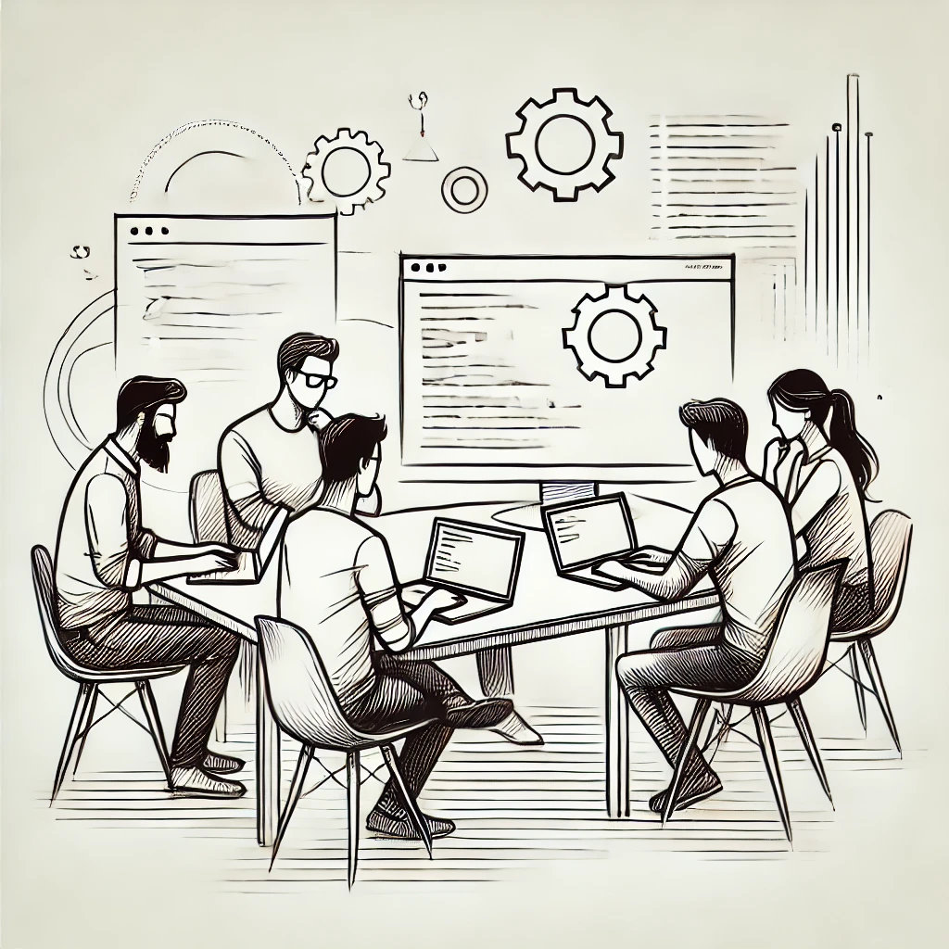

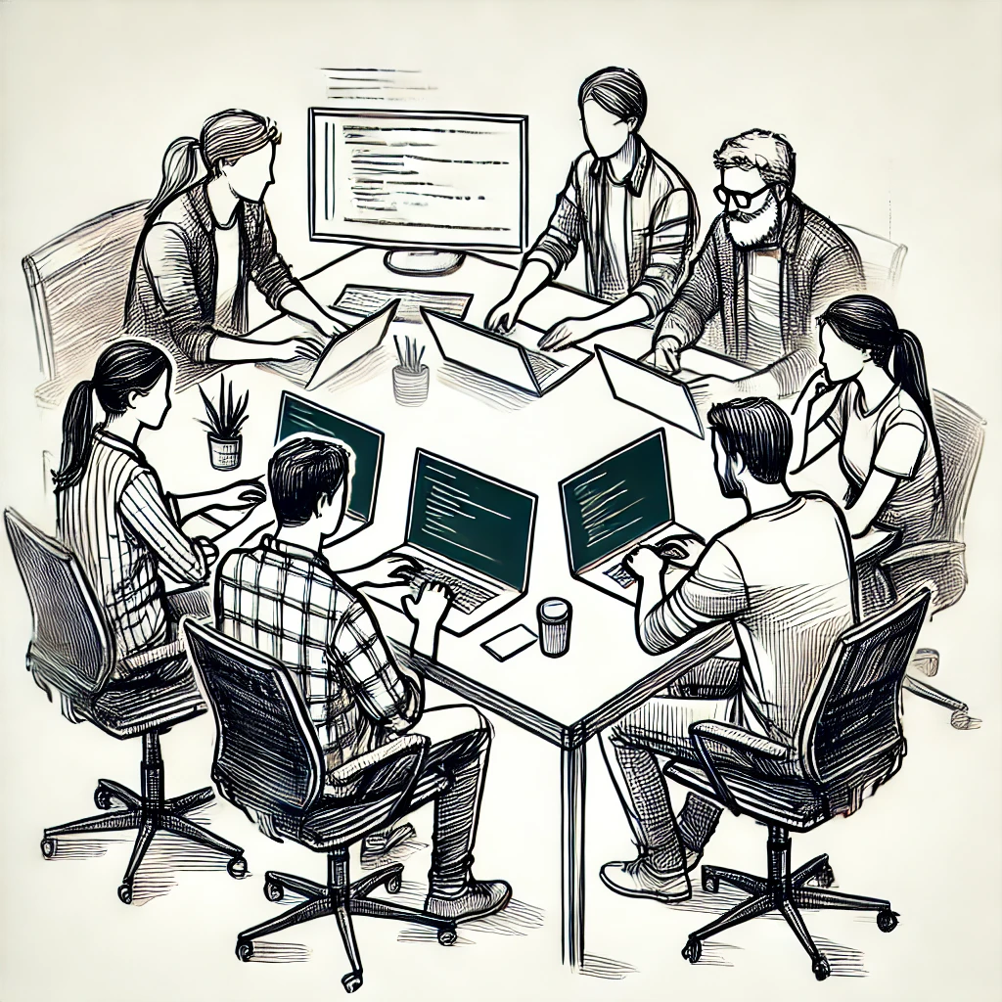
Be Careful…
Notes:
We’ve got to be a little careful here.
Once we move everyone over to the new table, we want to get rid of the old one.
But… what happens if we miss just one use case?

Slide 7





Oops…
Notes:
Well, there are a LOT of teams at Yelp. If we break the _right_ thing, in the _right_ way, we could end up causing an outage worth several times my yearly salary.
So yeah… lets not do that…

Slide 8
Renaming the table
session_summary
Notes:
Here’s the thing…. In my last few years of data engineering, one of the hard truths I’ve learned is with a migration of this size…
something definitely will go wrong. Someone always gets missed the first time.
so here’s what we’ll do…
Instead of deleting the table right away?
We rename it

Slide 9

Renaming the table
_session_summary
Notes:
The SLOs for the tables we maintain require us to fix an issue within 2-4 hours. I can restore a table name in far less time than that.
If we rename the table, and there are people still using it, they’ll get an error, and come talk to us.
This is the best part, this is where we learn about all the quirks, the forgotten jobs, the old dashboards laying around. all the views that people just use and have forgotten about.

Slide 10
Let’s start the migration!
session_summary
sessions

Slide 11
Let’s tell some people…
To: all-the-devs@yelp.com
To: all-the-devs@yelp.com
From: my-team@yelp.com
From: my-team@yelp.com
To: all-the-devs@yelp.com
Subject: session_summary is old
Subject: sessions is the way to go!
From: my-team@yelp.com
To: all-the-devs@yelp.com
This documentation is about the session_summary table which has been deprecated for years and contains multiple known bugs. DO NOT USE THIS TABLE.
Hello all
The current session_summary table is old and we no longer recommend using it. Please check out our migration guide for help figuring out how to use sessions instead
As always, happy to help if you have any issues!
My team
Hello,
The sessions table is new, and has a lot of really amazing features. Please use it instead of session_summary, which has a few critical bugs and differences.
Please tell us if you have any issues!
My team
Subject: session_summary is old
From: my-team@yelp.com
Hello Everyone!!!
We wanted to send a friendly reminder that the session_summary table is old, and we no longer recommend using it. Please use the sessions table instead.
Check it out and contact us if you have any issues!
My team
Subject: Don’t use session_summary
Hello,
This is a reminder that the session_summary table should not be used. It is old, and unreliable, and it has bugs. Please use the sessions table instead.
As always, happy to help if you have any issues!
My team

Slide 12
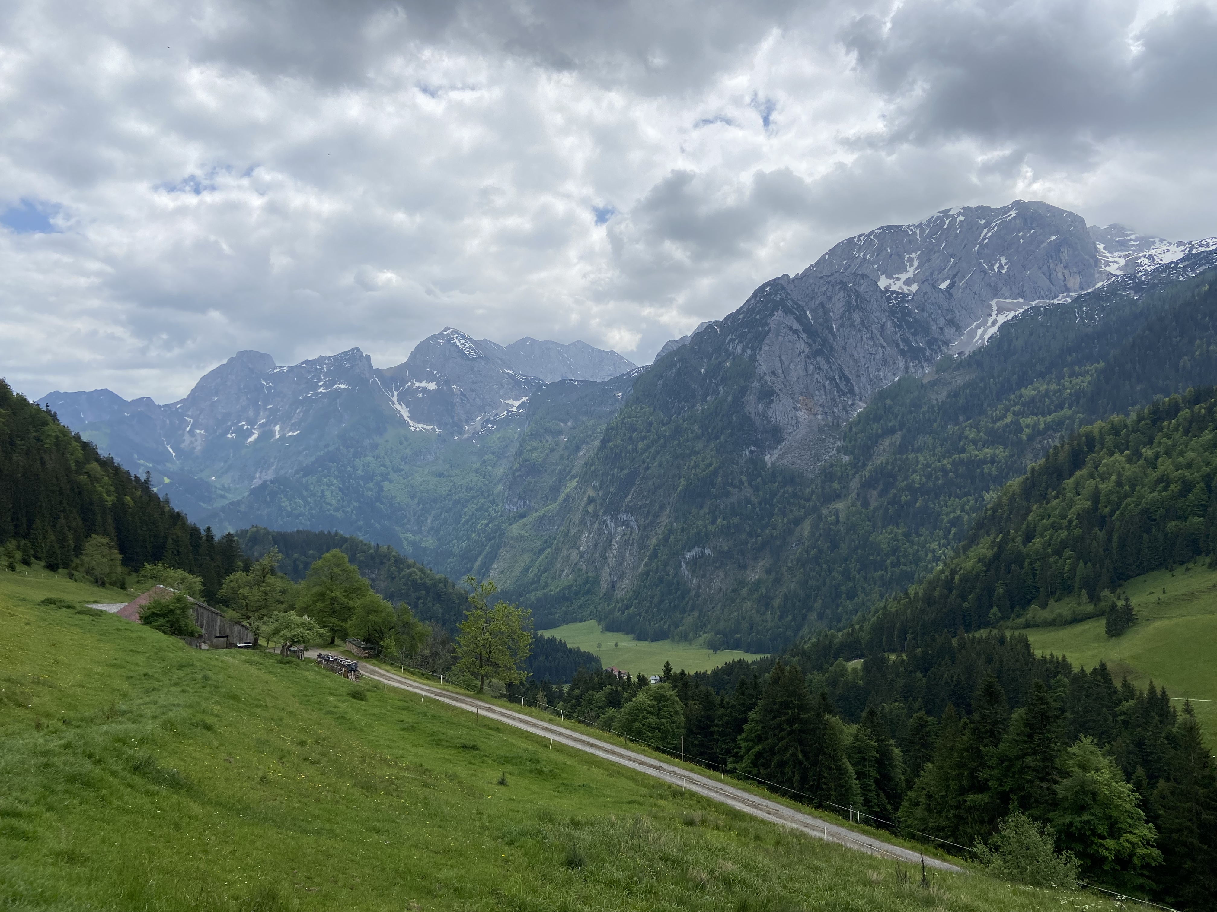

Slide 14
Are you using the
session_summary
table?

Slide 15

Are you using the
session_summary
table?
Oh… That’s legacy
dead code, we don’t’
run it anymore

Slide 16
What should we do?
Look for other ways to verify the table is DEFINITELY not used by any team
Rename the table. If the team says it’s not being used, that should be good enough.

Slide 17
Oops…

Slide 18
The problem with self-reporting:
Humans are imperfect

Slide 19

The Dashboard
Complete

Slide 20


Let’s find a way to double-check the table isn’t used

Slide 21
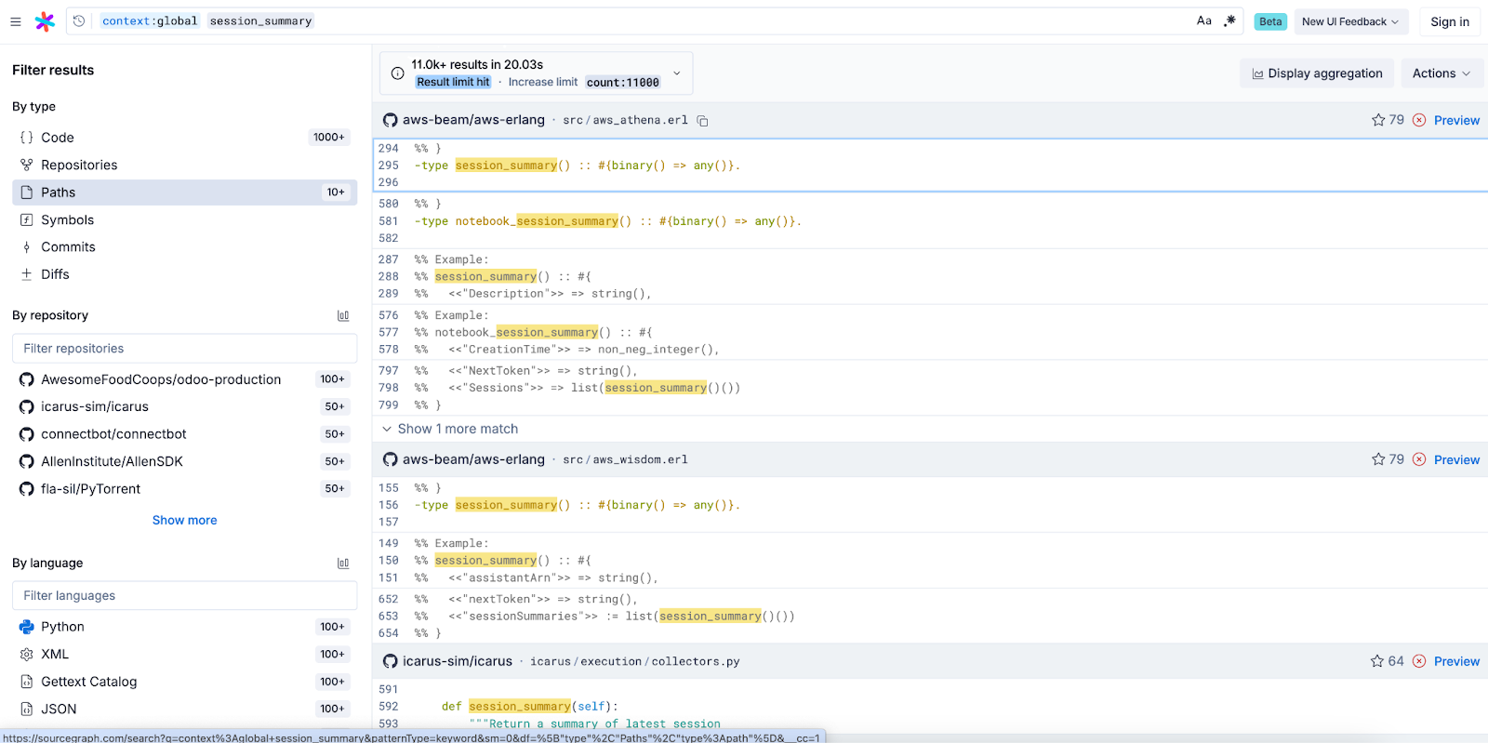
Code depicted here is not Yelp code, the image is used for illustrative purposes only

Slide 22
Code depicted here is not Yelp code, the image is used for illustrative purposes only

Slide 23
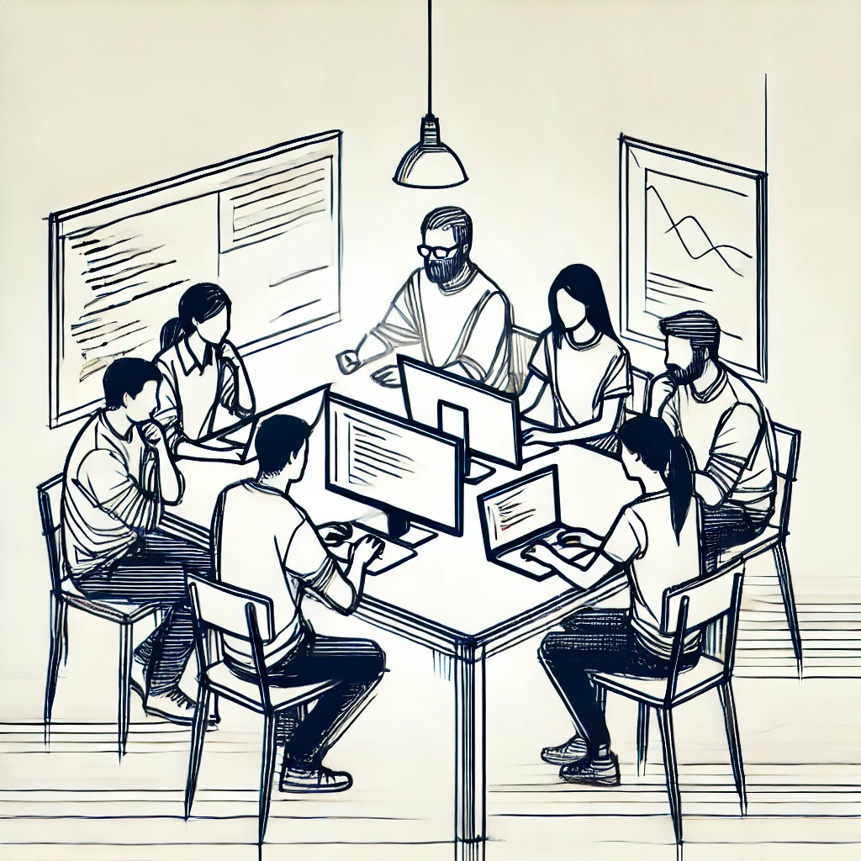

Slide 24


Slide 26
2 weeks later…

Slide 27
3 weeks later…

Slide 28


Slide 29
What should we do?
Rename the table.
Don’t rename the table.

Slide 30
Oops…

Slide 31
The problem with static analysis:
I can’t see the current state

Slide 32
Complete
Real-time

Slide 33

Let’s find a way to double-check the table isn’t used

Slide 34
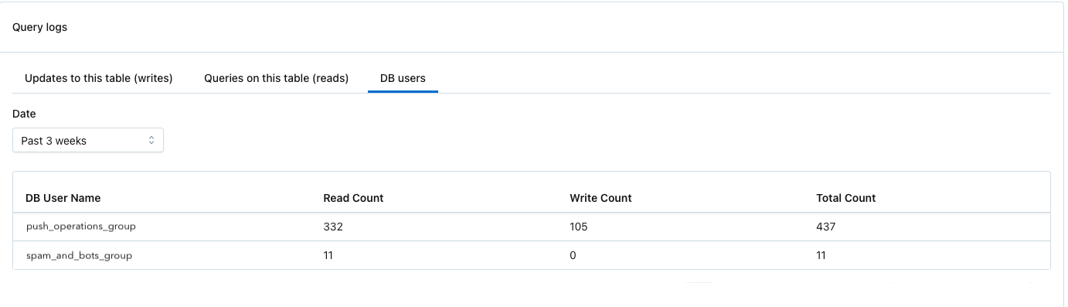
AI Data Observability
Past 3 months
push_operations/user_6
0
spam_and_bots/user_8
0
biz_quotes/user_2
514
review_personalization
0
514
security_and_reliability
0
secrel/batch
1002
1002

Slide 35
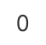
AI Data Observability
Past 2 days
push_operations/user_6
0
spam_and_bots/user_8
0
biz_quotes/user_2
514
review_personalization
0
514
security_and_reliability
52
0
secrel/batch
1002

Slide 36
Who do we Triple Check with?
3 months
2 days
A
push_operations/user_6 332
0
B
spam_and_bots/user_8 11
0
C
biz_quotes/user_2 514
0
D
secrel/batch 1002
52
None of them
C and D
D
We don’t have enough information

Slide 37
Oops…

Slide 38
The problem with third party tools:
Rigid Interfaces

Slide 39
Complete
Real-time
Configurable

Slide 40
Let’s find a way to find the recurring use cases

Slide 41


Slide 42


Slide 43
The Dashboard
date range:
table name:
last 3 months
session_summary
push_operations/user_6 332
spam_and_bots/user_8 11
biz_quotes/user_2 514
secrel/batch 1002

Slide 44
Complete
Real-time
Configurable

Slide 45
date range:
table name:
last 3 months
session_summary
Which jobs are still running??
date range:
table name:
user name:
last 3 months
session_summary
push_operations/user_6 332
spam_and_bots/user_8 11
biz_quotes/user_2 514
secrel/batch 1002

Slide 46
date range:
table name:
last 3 months
session_summary
Which jobs are still running??
date range:
table name:
user name:
last 3 months
session_summary
push_operations/user_6
?
push_operations/user_6 332
spam_and_bots/user_8 11
biz_quotes/user_2 514
secrel/batch 1002

Slide 47
date range:
table name:
last 3 months
session_summary
Which jobs are still running??
date range:
table name:
user name:
last 3 months
session_summary
push_operations/user_6 332
spam_and_bots/user_8 11
biz_quotes/user_2 514
secrel/batch 1002

Slide 48
date range:
table name:
last 3 months
session_summary
Which jobs are still running??
date range:
table name:
user name:
last 3 months
session_summary
spam_and_bots/user_8
?
push_operations/user_6 332
spam_and_bots/user_8 11
biz_quotes/user_2 514
secrel/batch 1002

Slide 49
date range:
table name:
last 3 months
session_summary
Which jobs are still running??
date range:
table name:
user name:
last 3 months
session_summary
spam_and_bots/user_8
push_operations/user_6 332
spam_and_bots/user_8 11
biz_quotes/user_2 514
secrel/batch 1002

Slide 50
date range:
table name:
last 3 months
session_summary
Which jobs are still running??
date range:
table name:
user name:
last 3 months
session_summary
push_operations/user_6 332
spam_and_bots/user_8 11
biz_quotes/user_2 514
secrel/batch 1002

Slide 51
date range:
table name:
last 3 months
session_summary
Which jobs are still running??
date range:
table name:
user name:
last 3 months
session_summary
biz_quotes/user_2
?
push_operations/user_6 332
spam_and_bots/user_8 11
biz_quotes/user_2 514
secrel/batch 1002

Slide 52
date range:
table name:
last 3 months
session_summary
Which jobs are still running??
date range:
table name:
user name:
last 3 months
session_summary
push_operations/user_6 332
spam_and_bots/user_8 11
biz_quotes/user_2 514
secrel/batch 1002

Slide 53
date range:
table name:
last 3 months
session_summary
Which users do we need to prioritize?
date range:
table name:
user name:
last 3 months
session_summary
secrel/batch
?
push_operations/user_6 332
spam_and_bots/user_8 11
biz_quotes/user_2 514
secrel/batch 1002

Slide 54


push_operations/user_6
spam_and_bots/user_8
biz_quotes/user_2
secrel/batch

Slide 55
Who is using my data?

Slide 56
Complete
Real-time
Configurable

Slide 57
How is the table being used?

Slide 58
The Streisand Effect
date range:
table name:
user name:
last 3 months
session_summary
number of queries per username
reviews/batch_user 32
marketing/user_4 418
2024-07-05
reviews/user_7 1

Slide 59
Who are the new users?
date range:
table name:
user name:
last 3 months
session_summary
number of queries per username
reviews/batch_user 32
marketing/user_4 418
reviews/user_7 1

Slide 60
date range:
table name:
last 3 months
session_summary
Who are the new users?
new usernames since first email
reviews/batch_user 32
marketing/user_4 418
reviews/user_7 1
security/user_8 56
analytics/batch 234

Slide 61

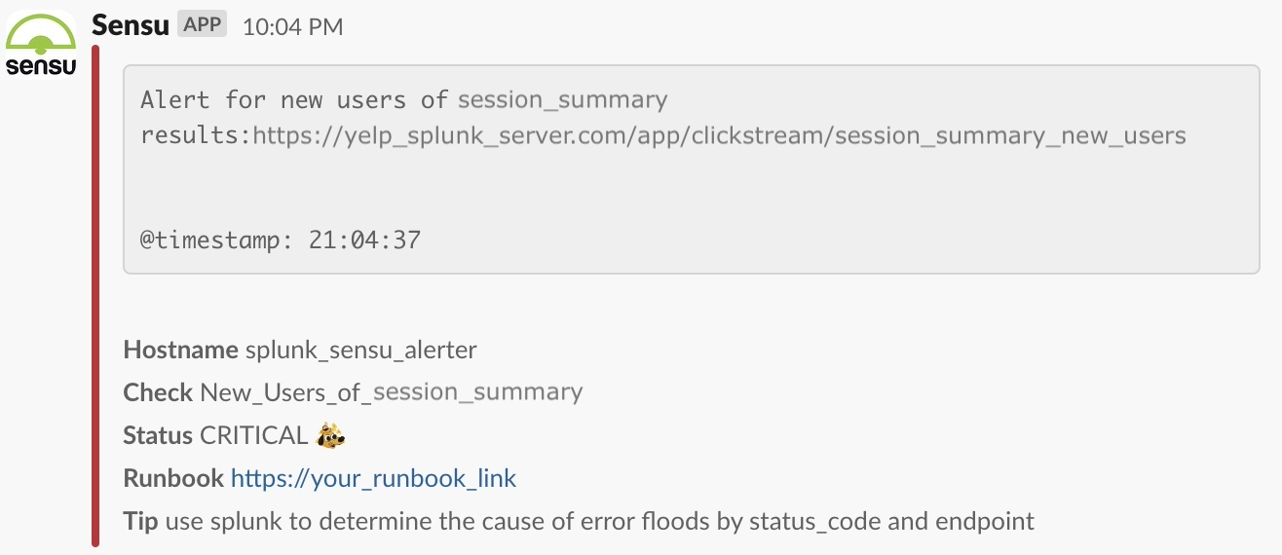
Code depicted here is not Yelp code, the image is used for illustrative purposes only

Slide 62
date range:
table name:
last 3 months
session_summary
The New Users
new usernames since first email
reviews/batch_user 32
marketing/user_4 418
reviews/user_7 1
security/user_8 56
analytics/batch 234

Slide 63
A SystemS Approach

Slide 64


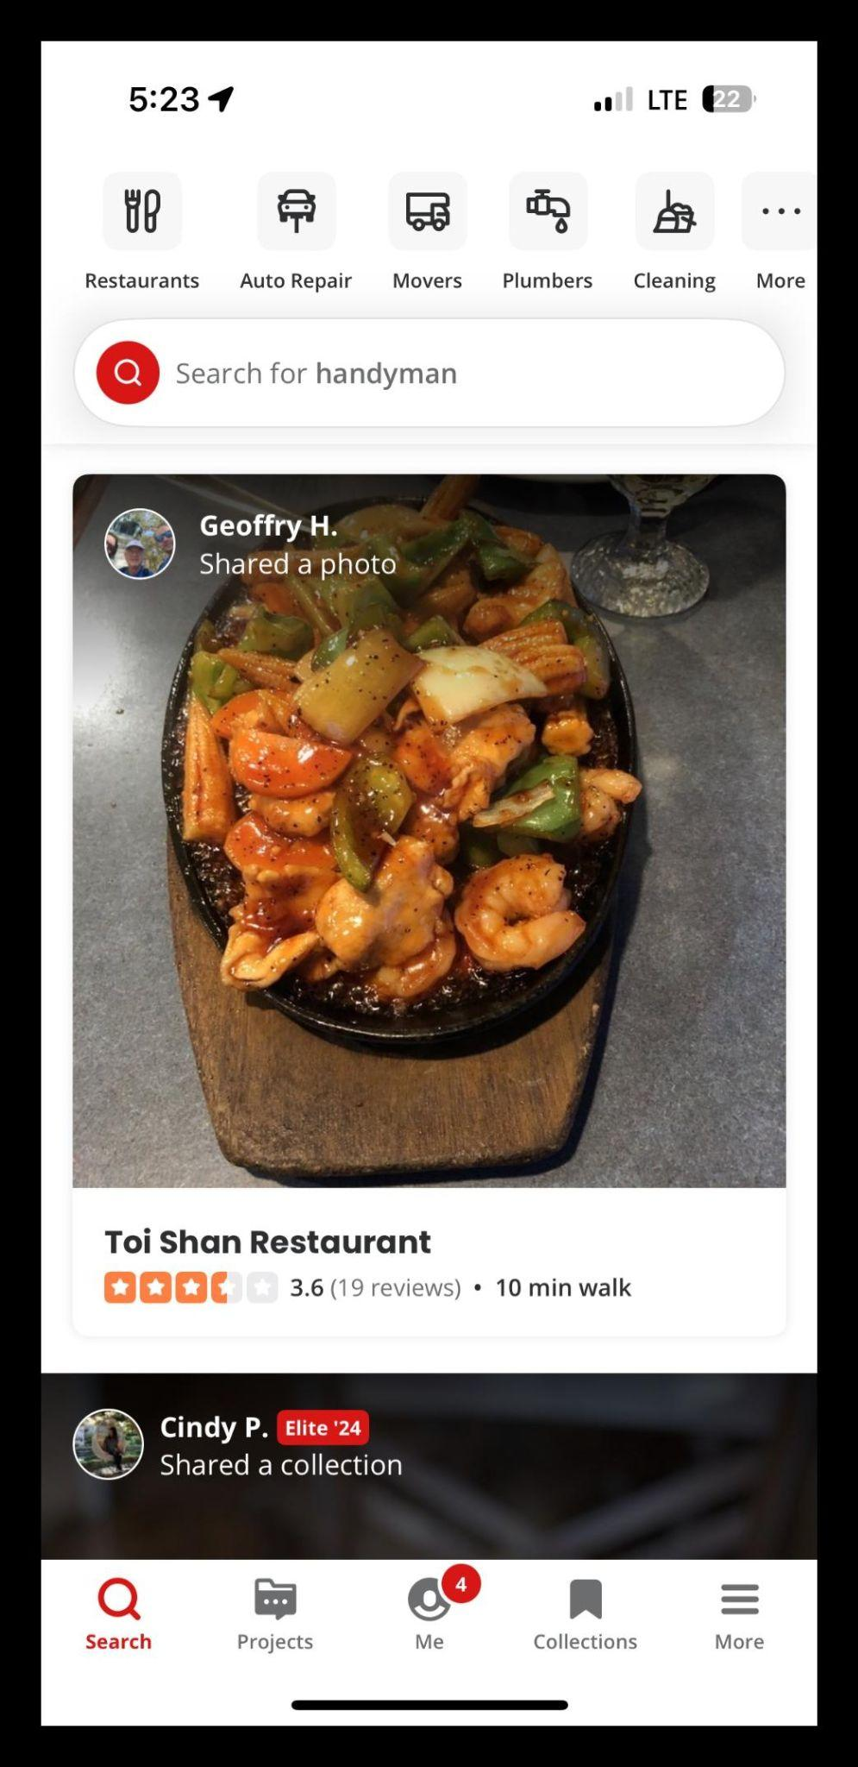



New button makes it easier to leave reviews!!!

Slide 66
We don’t say: Our customers are the ones who need to change their behaviour

Slide 67
We say: What about the new feature is making it harder for our customers to use?

Slide 68
What about the new table is making it harder for our dependent teams to use?

Slide 69
date range:
table name:
last 3 months
session_summary
Who are the new users?
new usernames since first email
reviews/batch_user 32
marketing/user_4 418
reviews/user_7 1
security/user_8 56
analytics/batch 234

Slide 70




date range:
table name:
last 3 months
session_summary
Which use cases should we address?
A
B
C
D
E
marketing/user_4
reviews/user_7
security/user_8
reviews/batch_user
analytics/batch

Slide 71






push_operations/user_6
spam_and_bots/user_8
biz_quotes/user_2
secrel/batch
marketing/user_4
reviews/user_7
security/user_8
reviews/batch_user
analytics/batch

Slide 72
What makes it hard to use the new table?
push_operations/user_6
spam_and_bots/user_8
biz_quotes/user_2
secrel/batch
marketing/user_4
reviews/user_7
security/user_8
reviews/batch_user
analytics/batch

Slide 73
date range:
table name:
last 3 months
session_summary
How is the team using the new table?
date range:
table name:
user name:
last 3 months
session_summary
spam_and_bots/user_8
spam_and_bots/user_8 11

Slide 74
date range:
table name:
last 3 months
session_summary
How is the team using the new table?
date range:
table name:
user name:
last 3 months
session_summary
spam_and_bots/user_8
spam_and_bots/user_8 11

Slide 75
The problem with analysis at a single level: You can’t see the details

Slide 76
Zoom In

Slide 77
date range:
table name:
last 3 months
session_summary
How is the team using the new table?
date range:
table name:
user name:
last 3 months
session_summary
spam_and_bots/user_8
spam_and_bots/user_8 11
queries
SELECT device_type, COUNT(*)
FROM session_summary
WHERE date = ‘2024-08-10’
AND is_bot = false
AND session_type = ‘timing’
GROUP BY device_type

Slide 78
SELECT device_type, COUNT(*)
FROM session_summary
WHERE date = ‘2024-08-10’
AND is_bot = false
AND session_type = ‘timing’
GROUP BY device_type
What will help the team
use the new table?
session_summary [OLD TABLE]
session_id | device_type | session_type | is_bot | date
ABC123 | android | review | true | 2024-08-10
DEF456 | ios | quote | false | 2024-08-10
GHI789 | web | timing | true | 2024-08-10
sessions [NEW TABLE]
session_id | device_type | session_type | is_bot | date
ABC123 | android | review | true | 2024-08-10
DEF456 | ios | quote | false | 2024-08-10
GHI789 | web | professional | true | 2024-08-10
Code depicted here is not Yelp code, the image is used for illustrative purposes only

Slide 79
SELECT device_type, COUNT(*)
FROM session_summary
WHERE date = ‘2024-08-10’
AND is_bot = false
AND session_type = ‘timing’
GROUP BY device_type
What will help the team
use the new table?
session_summary [OLD TABLE]
session_id | device_type | session_type | is_bot | date
ABC123 | android | review | true | 2024-08-10
DEF456 | ios | quote | false | 2024-08-10
GHI789 | web | timing | true | 2024-08-10
sessions [NEW TABLE]
session_id | device_type | session_type | is_bot | date
ABC123 | android | review | true | 2024-08-10
DEF456 | ios | quote | false | 2024-08-10
GHI789 | web | professional | true | 2024-08-10
Code depicted here is not Yelp code, the image is used for illustrative purposes only

Slide 80
SELECT device_type, COUNT(*)
FROM session_summary
WHERE date = ‘2024-08-10’
AND is_bot = false
AND session_type = ‘timing’
GROUP BY device_type
What will help the team
use the new table?
session_summary [OLD TABLE]
session_id | device_type | session_type | is_bot | date
ABC123 | android | review | true | 2024-08-10
DEF456 | ios | quote | false | 2024-08-10
GHI789 | web | timing | true | 2024-08-10
sessions [NEW TABLE]
session_id | device_type | session_type | is_bot | date
ABC123 | android | review | true | 2024-08-10
DEF456 | ios | quote | false | 2024-08-10
GHI789 | web | professional | true | 2024-08-10
Code depicted here is not Yelp code, the image is used for illustrative purposes only

Slide 81
SELECT device_type, COUNT(*)
FROM session_summary
WHERE date = ‘2024-08-10’
AND is_bot = false
AND session_type = ‘timing’
GROUP BY device_type
What will help the team
use the new table?
session_summary [OLD TABLE]
session_id | device_type | session_type | is_bot | date
ABC123 | android | review | true | 2024-08-10
DEF456 | ios | quote | false | 2024-08-10
GHI789 | web | timing | true | 2024-08-10
sessions [NEW TABLE]
session_id | device_type | session_type | is_bot | date
ABC123 | android | review | true | 2024-08-10
DEF456 | ios | quote | false | 2024-08-10
GHI789 | web | professional | true | 2024-08-10
Code depicted here is not Yelp code, the image is used for illustrative purposes only

Slide 82
SELECT device_type, COUNT(*)
FROM session_summary
WHERE date = ‘2024-08-10’
AND is_bot = false
AND session_type = ‘timing’
GROUP BY device_type
What will help the team
use the new table?
session_summary [OLD TABLE]
session_id | device_type | session_type | is_bot | date
ABC123 | android | review | true | 2024-08-10
DEF456 | ios | quote | false | 2024-08-10
GHI789 | web | timing | true | 2024-08-10
sessions [NEW TABLE]
session_id | device_type | session_type | is_bot | date
ABC123 | android | review | true | 2024-08-10
DEF456 | ios | quote | false | 2024-08-10
GHI789 | web | professional | true | 2024-08-10
Code depicted here is not Yelp code, the image is used for illustrative purposes only

Slide 83
SELECT device_type, COUNT(*)
FROM session_summary
WHERE date = ‘2024-08-10’
AND is_bot = false
AND session_type = ‘timing’
GROUP BY device_type
What will help the team
use the new table?
session_summary [OLD TABLE]
session_id | device_type | session_type | is_bot | date
ABC123 | android | review | true | 2024-08-10
DEF456 | ios | quote | false | 2024-08-10
GHI789 | web | timing | true | 2024-08-10
sessions [NEW TABLE]
session_id | device_type | session_type | is_bot | date
ABC123 | android | review | true | 2024-08-10
DEF456 | ios | quote | false | 2024-08-10
GHI789 | web | professional | true | 2024-08-10
Code depicted here is not Yelp code, the image is used for illustrative purposes only

Slide 84
SELECT device_type, COUNT(*)
FROM session_summary
WHERE date = ‘2024-08-10’
AND is_bot = false
AND session_type = ‘timing’
GROUP BY device_type
What will help the team
use the new table?
session_summary [OLD TABLE]
session_id | device_type | session_type | is_bot | date
ABC123 | android | review | true | 2024-08-10
DEF456 | ios | quote | false | 2024-08-10
GHI789 | web | timing | true | 2024-08-10
sessions [NEW TABLE]
session_id | device_type | session_type | is_bot | date
ABC123 | android | review | true | 2024-08-10
DEF456 | ios | quote | false | 2024-08-10
GHI789 | web | professional | true | 2024-08-10
Code depicted here is not Yelp code, the image is used for illustrative purposes only

Slide 85
SELECT device_type, COUNT(*)
FROM session_summary
WHERE date = ‘2024-08-10’
AND is_bot = false
AND session_type = ‘timing’
GROUP BY device_type
What will help the team
use the new table?
session_summary [OLD TABLE]
session_id | device_type | session_type | is_bot | date
ABC123 | android | review | true | 2024-08-10
DEF456 | ios | quote | false | 2024-08-10
GHI789 | web | timing | true | 2024-08-10
sessions [NEW TABLE]
session_id | device_type | session_type | is_bot | date
ABC123 | android | review | true | 2024-08-10
DEF456 | ios | quote | false | 2024-08-10
GHI789 | web | professional | true | 2024-08-10
Code depicted here is not Yelp code, the image is used for illustrative purposes only

Slide 86
SELECT device_type, COUNT(*)
FROM session_summary
WHERE date = ‘2024-08-10’
AND is_bot = false
AND session_type = ‘timing’
GROUP BY device_type
What will help the team
use the new table?
session_summary [OLD TABLE]
session_id | device_type | session_type | is_bot | date
ABC123 | android | review | true | 2024-08-10
DEF456 | ios | quote | false | 2024-08-10
GHI789 | web | timing | true | 2024-08-10
sessions [NEW TABLE]
session_id | device_type | session_type | is_bot | date
ABC123 | android | review | true | 2024-08-10
DEF456 | ios | quote | false | 2024-08-10
GHI789 | web | professional | true | 2024-08-10
Code depicted here is not Yelp code, the image is used for illustrative purposes only

Slide 87
What makes it hard to use the new table?
push_operations/user_6
spam_and_bots/user_8
biz_quotes/user_2
secrel/batch
marketing/user_4
reviews/user_7
security/user_8
reviews/batch_user
analytics/batch

Slide 88
Who else was confused?
date range:
table name:
user name:
last 3 months
session_summary
number of queries per username
reviews/batch_user 32
marketing/user_4 418
reviews/user_7 1

Slide 89
Zoom Out

Slide 90
Who else was confused?
users with queries looking for ‘timing’
spam_and_bots/user_8 11
secrel/batch 172
analytics/batch 234

Slide 91
What makes it hard to use the new table?
push_operations/user_6
spam_and_bots/user_8
biz_quotes/user_2
secrel/batch
marketing/user_4
reviews/user_7
security/user_8
reviews/batch_user
analytics/batch

Slide 92


secrel/batch
Just so you know,
‘timing’ is equivalent to ‘professional’ in the new table
Oh wow! thanks!
That’s the last piece we needed to migrate!

Slide 93
The remaining use cases
push_operations/user_6
spam_and_bots/user_8
biz_quotes/user_2
secrel/batch
marketing/user_4
reviews/user_7
security/user_8
reviews/batch_user
analytics/batch

Slide 94
The remaining use cases:
push_operations/user_6
spam_and_bots/user_8
biz_quotes/user_2
secrel/batch
marketing/user_4
reviews/user_7
security/user_8
reviews/batch_user
analytics/batch

Slide 95

analytics/batch
Just so you know,
‘professional’ is equivalent to ‘timing’ in the new table
Thanks for letting us know! We’ll change it!

Slide 96
The remaining use cases:
push_operations/user_6
spam_and_bots/user_8
biz_quotes/user_2
secrel/batch
marketing/user_4
reviews/user_7
security/user_8
reviews/batch_user
analytics/batch

Slide 97

date range:
table name:
last 3 months
session_summary
The remaining use cases:

Slide 98
The remaining use cases:
push_operations/user_6
spam_and_bots/user_8
biz_quotes/user_2
secrel/batch
marketing/user_4
reviews/user_7
security/user_8
reviews/batch_user
analytics/batch

Slide 99
Zoom In

Slide 100
date range:
table name:
last 3 months
session_summary
What makes it hard to use the new table?
date range:
table name:
user name:
last 3 months
session_summary
analytics/batch
number of queries per username
analytics/batch 418
queries
SELECT business_type, session_id
FROM session_summary
WHERE is_bot = false
AND session_type = ‘timing’
Code depicted here is not Yelp code, the image is used for illustrative purposes only

Slide 101


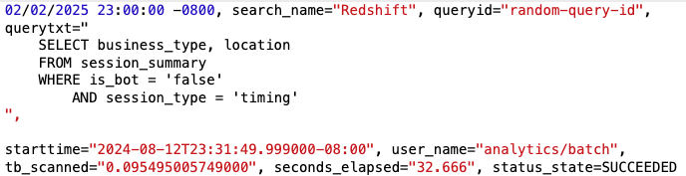
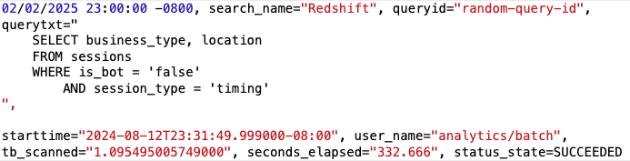
It’s about more than just query text
The old table
32 s
SELECT business_type, session_id
FROM session_summary
WHERE is_bot = false
AND session_type = ‘timing’
The new table
332 s
SELECT business_type, session_id
FROM sessions
WHERE is_bot = false
AND session_type = ‘professional’
’professional’
Code depicted here is not Yelp code, the image is used for illustrative purposes only

Slide 102
Zoom Out

Slide 103
date range:
table name:
last 3 months
session_summary
What makes it hard to use the new table?
date range:
table name:
user name:
last 3 months
session_summary
average time to complete query: 40 seconds
number of queries per username
number of queries per username
marketing/user_1 105
security/user_8 56
analytics/batch 234
queries
SELECT business_type, session_id
FROM session_summary
WHERE is_bot = false
AND session_type = ‘timing’
Code depicted here is not Yelp code, the image is used for illustrative purposes only

Slide 104
date range:
table name:
last 3 months
session_summary
What makes it hard to use the new table?
date range:
table name:
user name:
last 3 months
sessions
average time to complete query: 400 seconds
number of queries per username
marketing/user_1 105
push/user_8 1504
bots/batch_user 72
queries
SELECT business_type, is_bot, session_id
FROM sessions
WHERE is_bot = false
AND location= ‘US’
Code depicted here is not Yelp code, the image is used for illustrative purposes only

Slide 105
The remaining use cases:
push_operations/user_6
spam_and_bots/user_8
biz_quotes/user_2
secrel/batch
marketing/user_4
reviews/user_7
security/user_8
reviews/batch_user
analytics/batch

Slide 106


Slide 107
The Incident

Slide 108


The Incident

Slide 109


biz_sessions
The Incident
biz_app_event
email_event
push_event
user_actions
waitlist_click
search_data
biz_event

Slide 110
Complete

Slide 111
push_event
email_event
biz_app_event
user_actions
waitlist_click
biz_event
biz_sessions
search_data

Slide 112
Complete
Real-time

Slide 113




































biz_app_event
80
biz_sessions
30
waitlist_click
3

Slide 114
Complete
Real-time
Configurable

Slide 115

biz_app_event
5
biz_sessions
1
waitlist_click
0

Slide 116
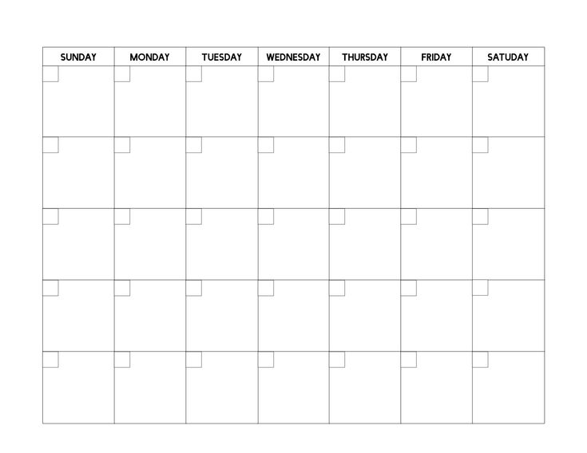
Sept 2024
August 2022
Sept 2022
6 weeks
July 2024
2 days

Slide 117
Sept 2024
August 2022
Sept 2022
6 weeks
July 2024
2 weeks

Slide 118
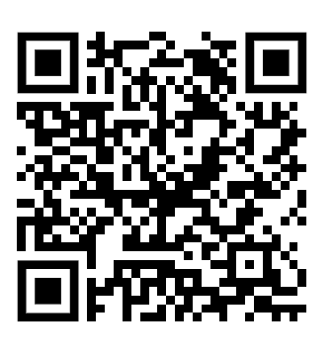
Thank You!
Llewellyn Falco
Susan Fung
Rocky Rhodes
Jonathan Rioux
Jessica Kerr
Matt Hughes
Diana Sherwood
Tony Vo

